Slide 1
Boston Sightseeing – A Mathematical Approach
OR6205 13611 Deterministic Ops Research SEC 09 Fall 2019
Abhilash Janardhanan
Shashank Shet
Pratik Nagare

Slide 2
Motivations and Problem Statement

Slide 3
Methodology
Web scrapping the data from Trip Advisor.
Selecting locations based on certain parameters suitable for tourists and deciding the locations to be used.
Coordinates and distance calculation between the locations.

Slide 4
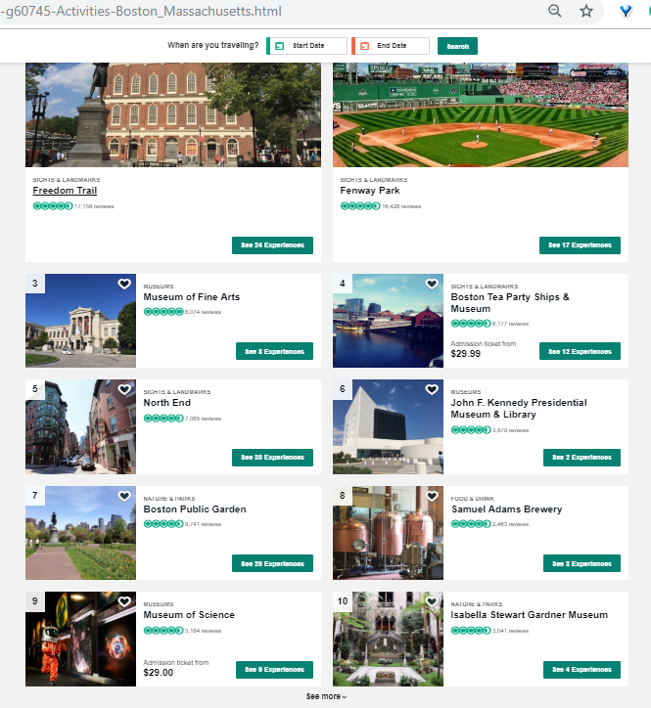
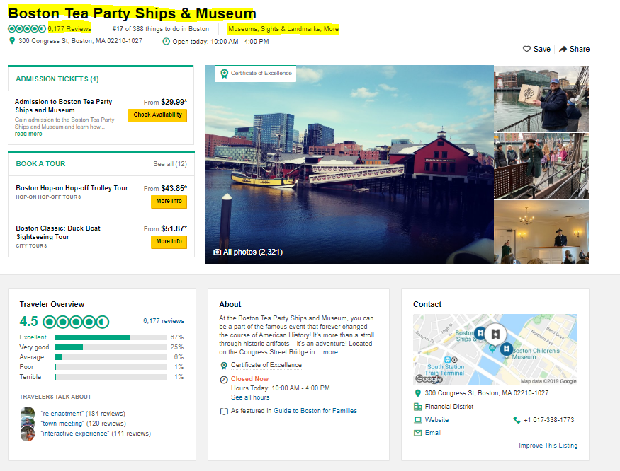
Information within Trip Advisor pages

Slide 5
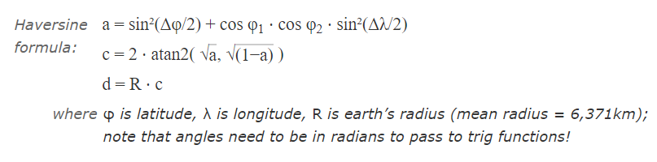
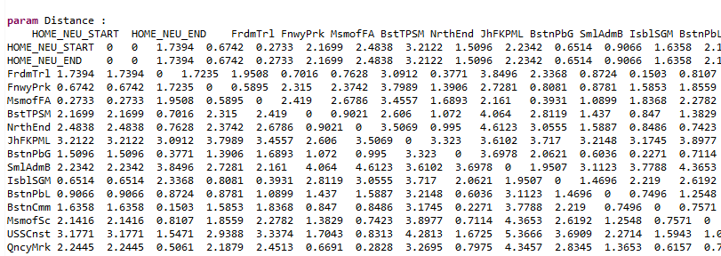
Distance calculations using Haversine formula
Source: https://www.movable-type.co.uk/scripts/latlong.html

Slide 6
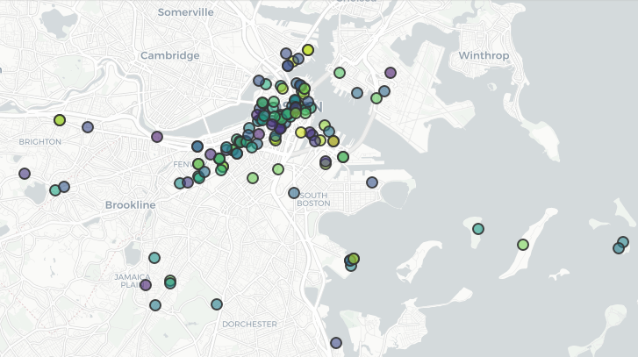
Sightseeing Locations

Slide 7
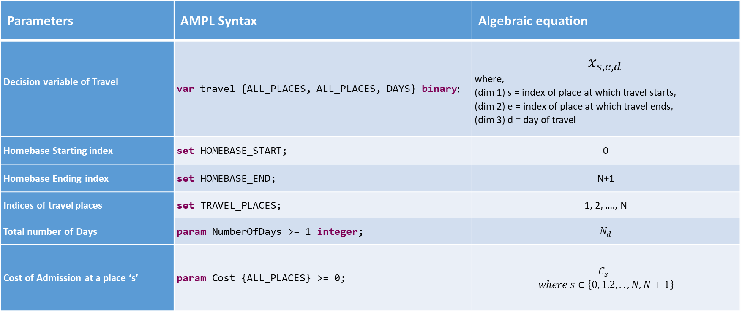
Problem Parameters
Parameters | AMPL Syntax | Algebraic equation
Decision variable of Travel | var travel {ALL_PLACES, ALL_PLACES, DAYS} binary; | $$x_{s,e,d }$$ where, (dim 1) s = index of place at which travel starts, (dim 2) e = index of place at which travel ends, (dim 3) d = day of travel
Homebase Starting index | set HOMEBASE_START; | 0
Homebase Ending index | set HOMEBASE_END; | N+1
Indices of travel places | set TRAVEL_PLACES; | 1, 2, …., N
Total number of Days | param NumberOfDays >= 1 integer; | $$N_{d}$$
Cost of Admission at a place ‘s’ | param Cost {ALL_PLACES} >= 0; | $C_{s}$ $$where s∈\left\{0, 1,2, ..,N, N+1\right\}$$

Slide 8
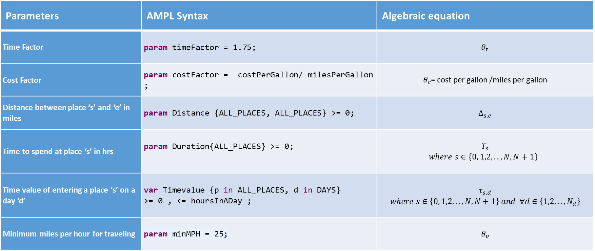
Problem Parameters (… contd)
Parameters | AMPL Syntax | Algebraic equation
Time Factor | param timeFactor = 1.75; | $$θ_{t}$$
Cost Factor | param costFactor = costPerGallon/ milesPerGallon ; | $θ_{c}$= cost per gallon /miles per gallon
Distance between place ‘s’ and ‘e’ in miles | param Distance {ALL_PLACES, ALL_PLACES} >= 0; | $$∆_{s,e}$$
Time to spend at place ‘s’ in hrs | param Duration{ALL_PLACES} >= 0; | $$T_{s}$$ $where s∈\left\{0, 1,2, ..,N, N+1\right\}$
Time value of entering a place ‘s’ on a day ‘d’ | var Timevalue {p in ALL_PLACES, d in DAYS} >= 0 , <= hoursInADay ; | $$τ_{s,d}$$ $$where s∈\left\{0, 1,2, ..,N, N+1\right\} and ∀d∈\left\{1,2, ..,N_{d}\right\}$$
Minimum miles per hour for traveling | param minMPH = 25; | $$θ_{v}$$

Slide 9
Goals
To find:
The maximum number of places that can be visited.
The order of the places that the person should visit.
Total cost incurred during the visit.

Slide 10
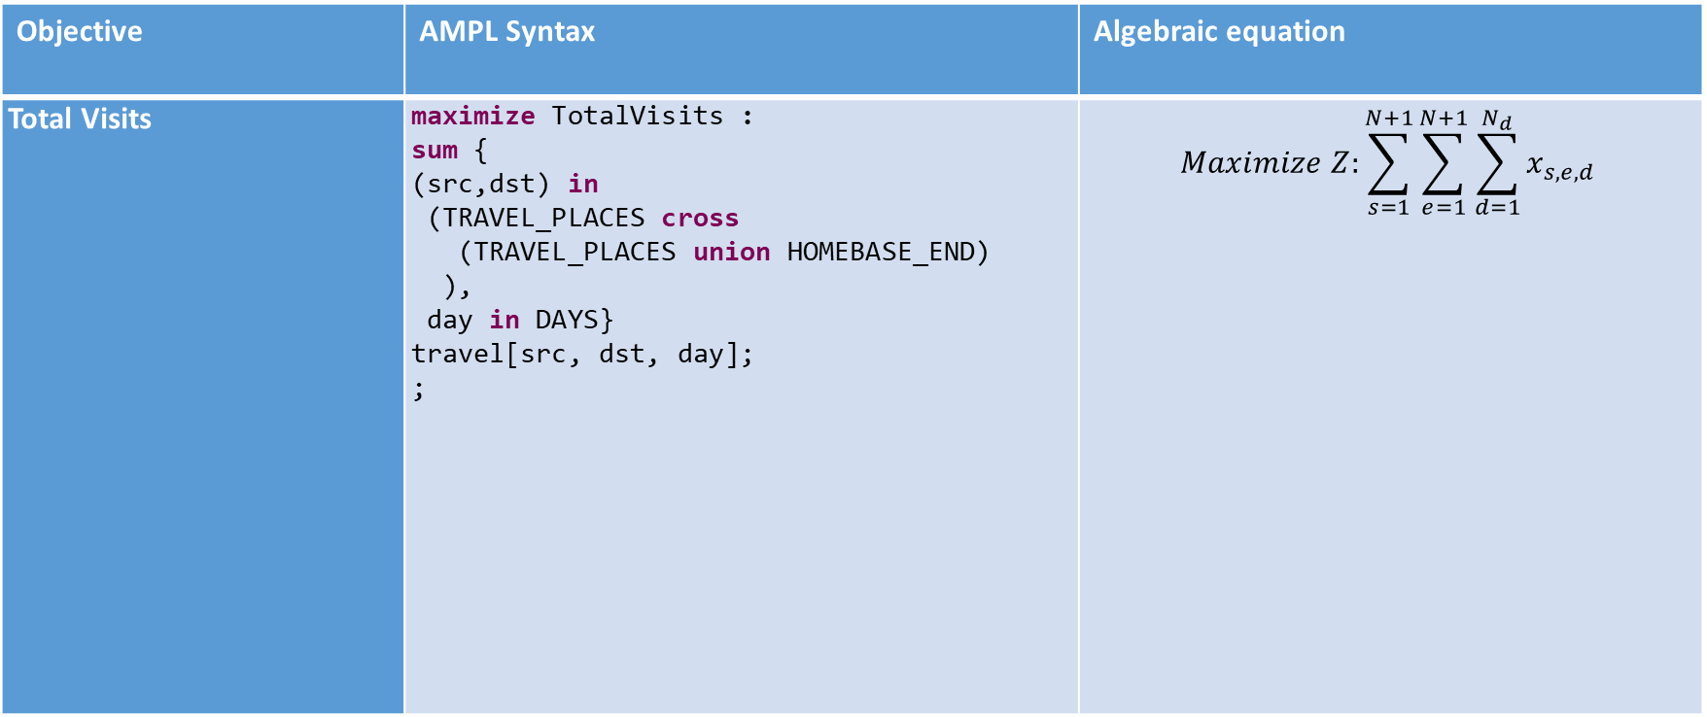
Objective Function
Objective | AMPL Syntax | Algebraic equation
Total Visits | maximize TotalVisits : sum { (src,dst) in (TRAVEL_PLACES cross (TRAVEL_PLACES union HOMEBASE_END) ), day in DAYS} travel[src, dst, day]; ; | $$Maximize Z:\sum_{s=1}^{N+1}{\sum_{e=1}^{N+1}{\sum_{d=1}^{N_{d}}{x_{s,e,d }}}}$$

Slide 11
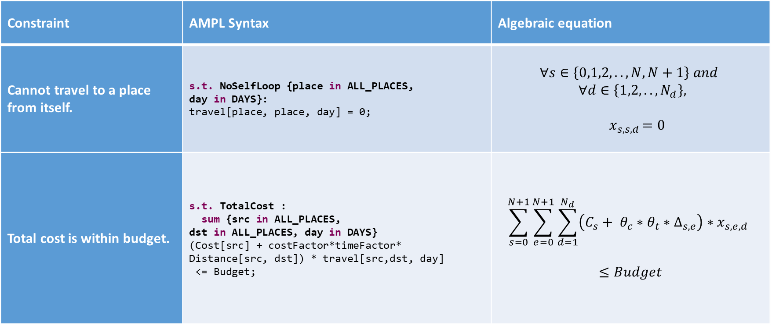
Travel Constraints
Constraint | AMPL Syntax | Algebraic equation
Cannot travel to a place from itself. | s.t. NoSelfLoop {place in ALL_PLACES, day in DAYS}: travel[place, place, day] = 0; | $$∀s∈\left\{0,1,2, ..,N, N+1\right\} and$$ $$∀d∈\left\{1,2, ..,N_{d}\right\},$$ $${ x}_{s,s,d }=0$$
Total cost is within budget. | s.t. TotalCost : sum {src in ALL_PLACES, dst in ALL_PLACES, day in DAYS} (Cost[src] + costFactor*timeFactor* Distance[src, dst]) * travel[src,dst, day] <= Budget; | $$\sum_{s=0}^{N+1}{\sum_{e=0}^{N+1}{\sum_{d=1}^{N_{d}}{{\left(C_{s}+ θ_{c}∗θ_{t}∗∆_{s,e}\right)∗x_{s,e,d }}_{ }}}}$$ $$≤Budget$$

Slide 12
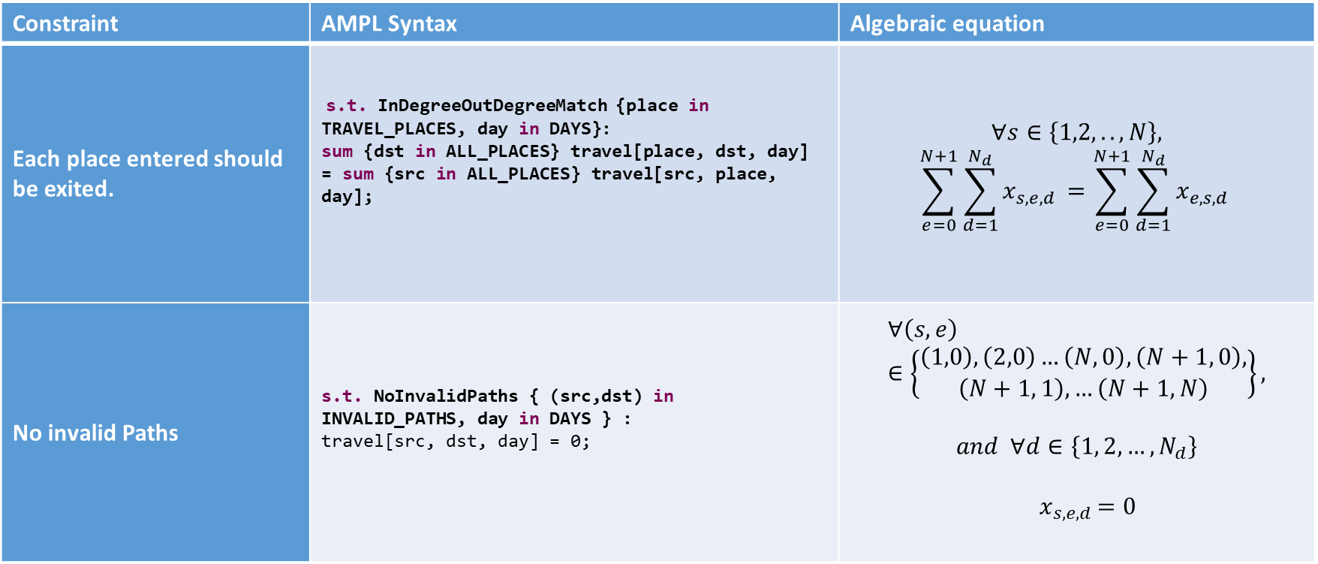
Travel Constraints
Constraint | AMPL Syntax | Algebraic equation
Each place entered should be exited. | s.t. InDegreeOutDegreeMatch {place in TRAVEL_PLACES, day in DAYS}: sum {dst in ALL_PLACES} travel[place, dst, day] = sum {src in ALL_PLACES} travel[src, place, day]; | $$∀s∈\left\{1,2, ..,N\right\},$$ $$\sum_{e=0}^{N+1}{\sum_{d=1}^{N_{d}}{x_{s,e,d }}}=\sum_{e=0}^{N+1}{\sum_{d=1}^{N_{d}}{x_{e,s,d }}}$$
No invalid Paths | s.t. NoInvalidPaths { (src,dst) in INVALID_PATHS, day in DAYS } : travel[src, dst, day] = 0; | $$∀\left(s,e\right)∈\left\{\begin{aligned}\left(1,0\right), \left(2,0\right)…\left(N, 0\right),\left(N+1, 0\right), \\ \left(N+1, 1\right),…\left(N+1,N\right)\end{aligned}\right\},$$ $$and ∀d∈\left\{1, 2, …,N_{d}\right\}$$ $${ x}_{s,e,d }=0$$

Slide 13
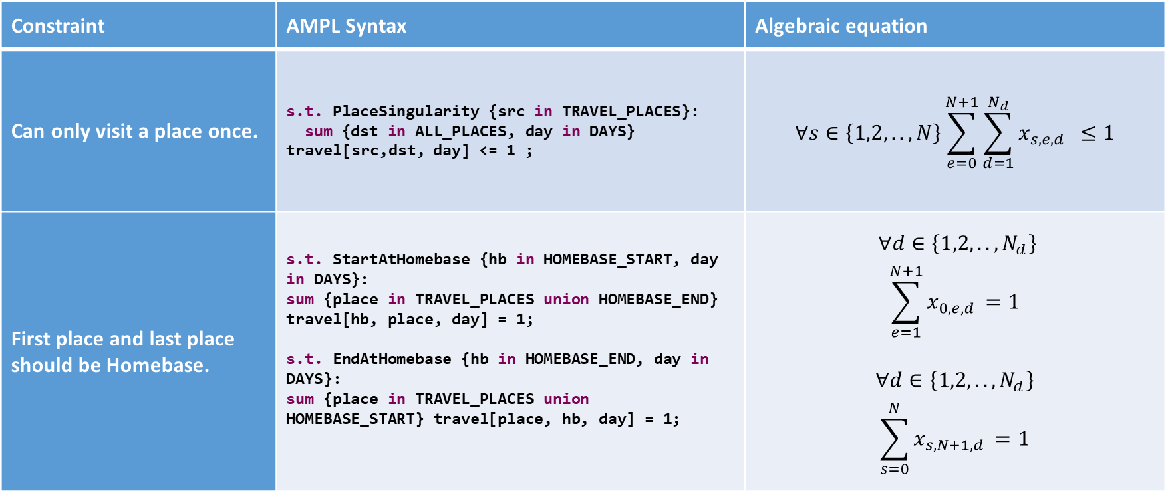
Travel Constraints
Constraint | AMPL Syntax | Algebraic equation
Can only visit a place once. | s.t. PlaceSingularity {src in TRAVEL_PLACES}: sum {dst in ALL_PLACES, day in DAYS} travel[src,dst, day] <= 1 ; | $$∀s∈\left\{1,2, ..,N\right\}\sum_{e=0}^{N+1}{\sum_{d=1}^{N_{d}}{{x_{s,e,d }}_{ }}}≤1$$
First place and last place should be Homebase. | s.t. StartAtHomebase {hb in HOMEBASE_START, day in DAYS}: sum {place in TRAVEL_PLACES union HOMEBASE_END} travel[hb, place, day] = 1; s.t. EndAtHomebase {hb in HOMEBASE_END, day in DAYS}: sum {place in TRAVEL_PLACES union HOMEBASE_START} travel[place, hb, day] = 1; | $$∀d∈\left\{1,2, ..,N_{d}\right\}$$ $$\sum_{e=1}^{N+1}{x_{0,e,d }}=1$$ $$∀d∈\left\{1,2, ..,N_{d}\right\}$$ $$\sum_{s=0}^{N}{x_{s,N+1,d }}=1$$

Slide 14
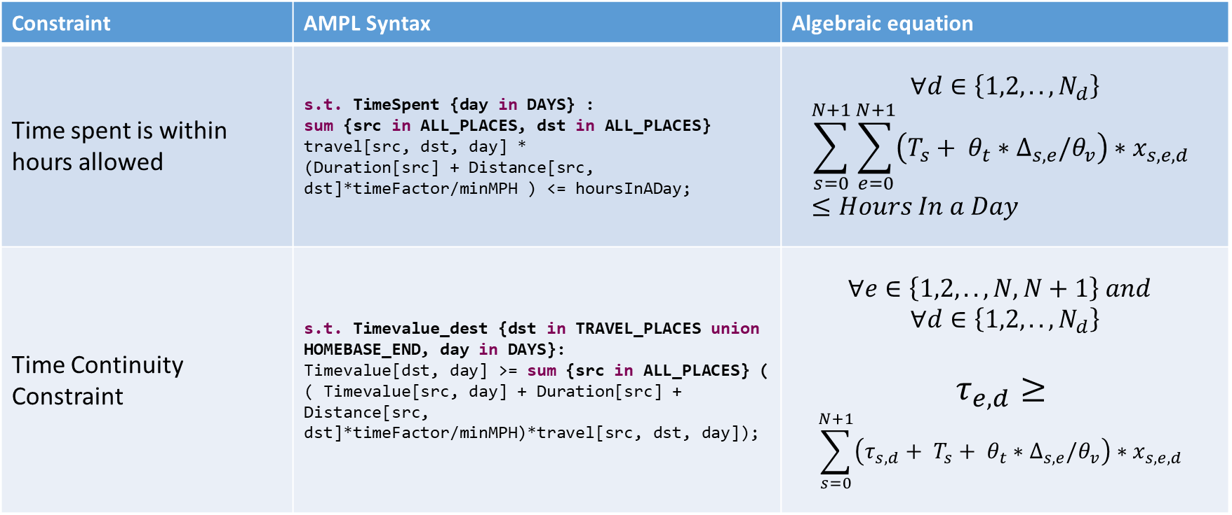
Time Constraints
Constraint | AMPL Syntax | Algebraic equation
Time spent is within hours allowed | s.t. TimeSpent {day in DAYS} : sum {src in ALL_PLACES, dst in ALL_PLACES} travel[src, dst, day] * (Duration[src] + Distance[src, dst]*timeFactor/minMPH ) <= hoursInADay; | $$∀d∈\left\{1,2, ..,N_{d}\right\}$$ $$\sum_{s=0}^{N+1}{\sum_{e=0}^{N+1}{{\left(T_{s}+ θ_{t}∗∆_{s,e}/θ_{v}\right)∗x_{s,e,d }}_{ }}}≤Hours In a Day$$
Time Continuity Constraint | s.t. Timevalue_dest {dst in TRAVEL_PLACES union HOMEBASE_END, day in DAYS}: Timevalue[dst, day] >= sum {src in ALL_PLACES} ( ( Timevalue[src, day] + Duration[src] + Distance[src, dst]*timeFactor/minMPH)*travel[src, dst, day]); | $$∀e∈\left\{1,2, ..,N, N+1\right\} and$$ $$∀d∈\left\{1,2, ..,N_{d}\right\}$$ $$τ_{e,d}≥$$ $$\sum_{s=0}^{N+1}{{\left(τ_{s,d}+ T_{s}+ θ_{t}∗∆_{s,e}/θ_{v}\right)∗x_{s,e,d }}_{ }}$$

Slide 15
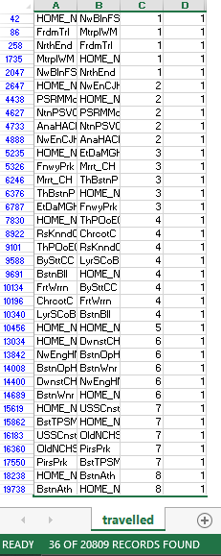
Results
The image shows the places visited on the specific date as obtained in the ‘travelled.tab’ file.
These results are based on the base values which are:
Budget spent on the tour = 200 dollars
Number of hours in a day = 10 hours
Number of days = 8 days

Slide 16
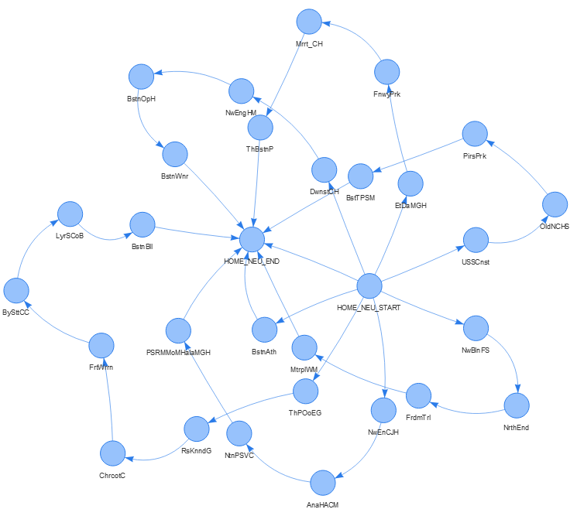
Output Paths

Slide 17
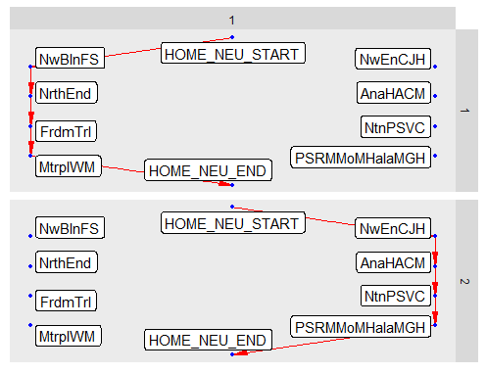
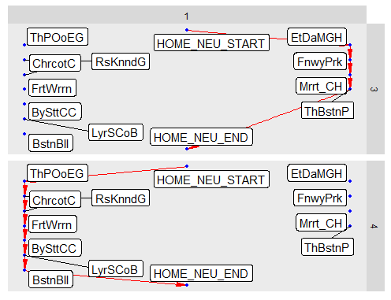
Output Paths per Day

Slide 18
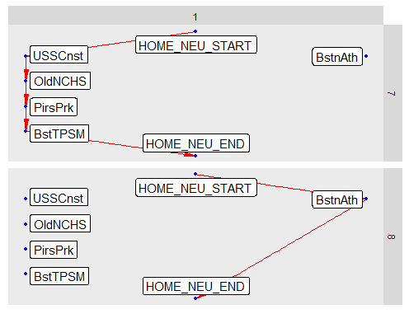
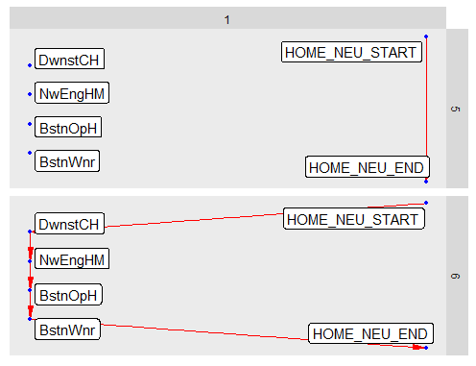
Output Paths per Day (..contd)

Slide 19
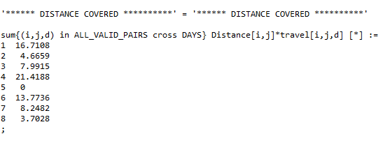
Distance travelled per day as seen on AMPL Console

Slide 20
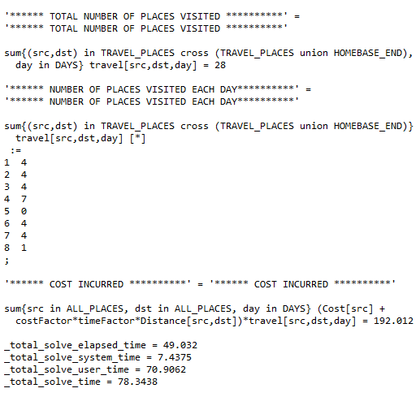
Total number of places visited, number of places visited each day and Cost incurred as seen on AMPL Console.
The various computing times that have been calculated are also visible.
The computing times will vary depending upon the specifications of the computer.

Slide 21
Sensitivity Analysis
We carried out sensitivity analysis to find out the impact on objective function and dependent variables caused by change in independent variable values.
The Sensitive Analysis were performed based on:
Change in budget available.
Change in travel hours of a day.
Change in number of days of travel.

Slide 22
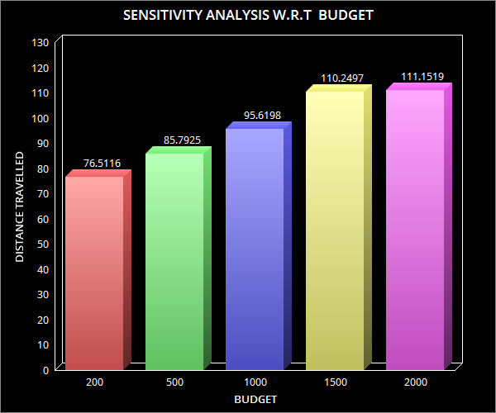
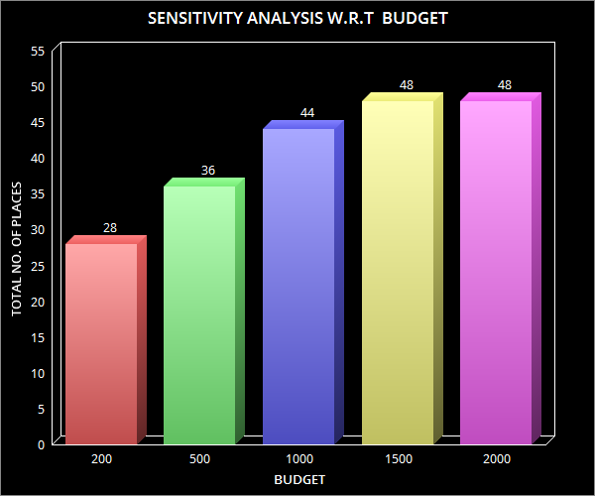
Sensitivity Analysis w.r.t. Budget Available

Slide 23
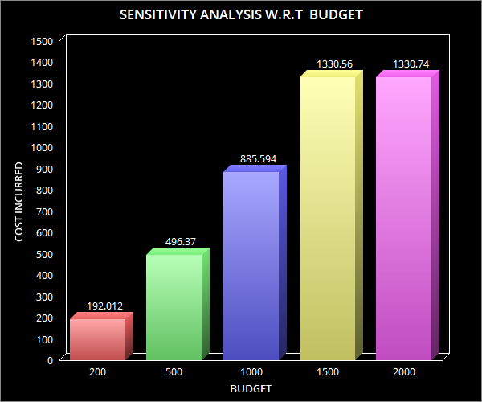
Sensitivity Analysis w.r.t. Budget Available

Slide 24
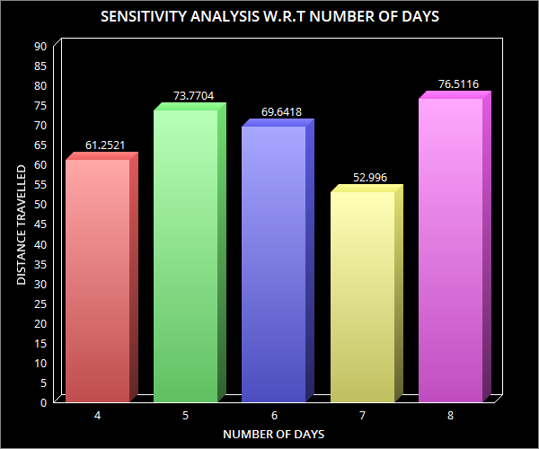
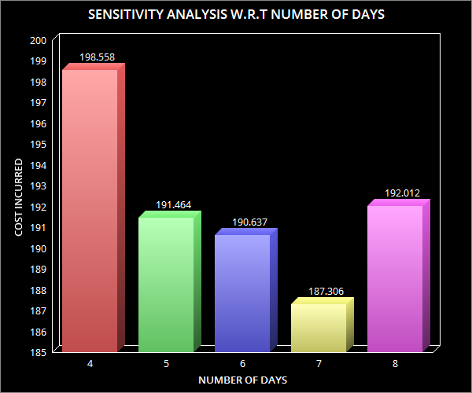
Sensitivity Analysis w.r.t. Days of Travel

Slide 25
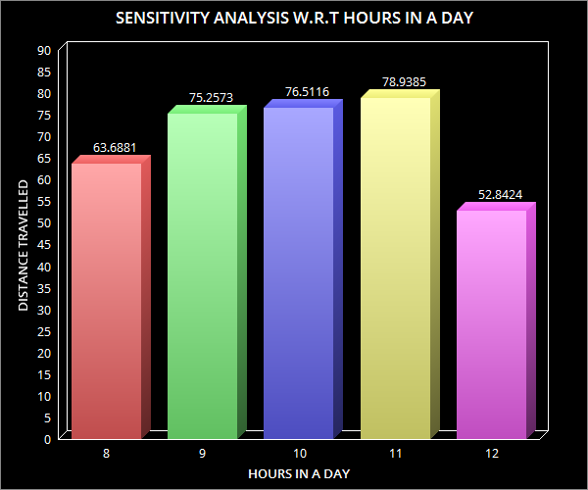
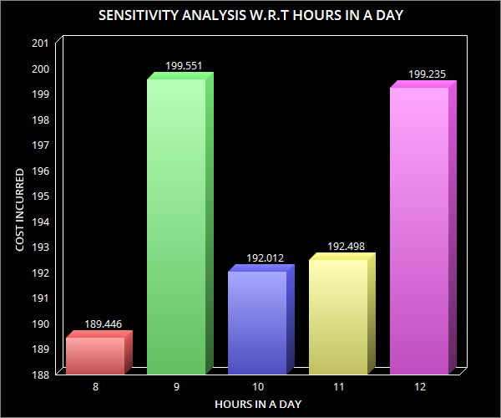
Sensitivity Analysis w.r.t. Travel hours in a day

Slide 26
Future scope and improvements
Obtaining accurate distance of transportation and incorporating different modes of transport .
Accessibility of sightseeing locations.
Incorporating personal preferences
Incorporating Mandated breaks/Restaurant travel for eating times during the trip
Optimization results provided at a more granular level, say, hour-level
Adding weather information to influence decision

